Slide 1

Understanding Health Equity in the Upper Valley
Rudy Fedrizzi, MD
District Director of Public Health Services – WRJ Office
Lyrica Stelle, MPH
Epidemiologist – WRJ Office
February 11, 2022

Slide 2
Terms
Heath Equity (from Robert Wood Johnson Foundation) – everyone has a fair and just opportunity to be as healthy as possible. This requires removing obstacles to health such as poverty, discrimination, and their consequences, including powerlessness and lack of access to good jobs with fair pay, quality education and housing, safe environments, and healthcare.
Health Inequities – differences in health outcomes that are systematic, avoidable, and unjust
Health Disparities – differences in health, whether unjust or not

Slide 3
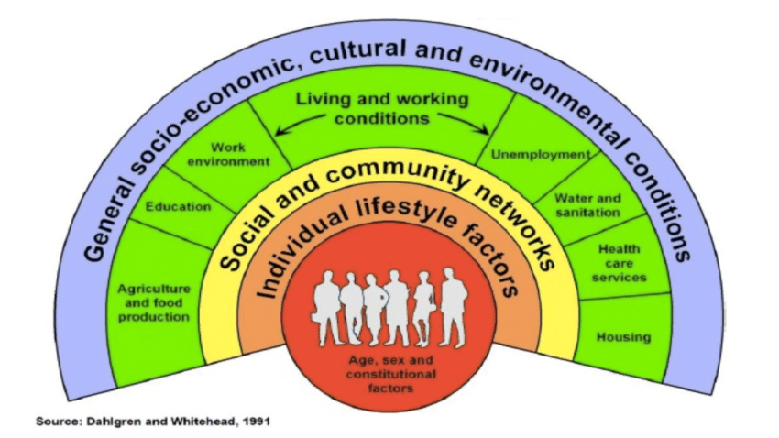
One Model of Social Factors that Influence Health
Healthcare only accounts for about 10-15% of overall health

Slide 4

The Importance of Framing Health Equity
Most Americans think health is an individual’s choice rather than a consequence of social factors and opportunity
To many, Equity means something financial about the value in one’s house
Best Practices:
Focus on fairness, justice, benefits for everyone
Explain how policies and systems lead to poor health for some people
Lead with inspiration and be aspirational
Explain how disparities arose rather than who is experiencing them
Be clear that solutions exist
https://www.dialogue4health.org/web-forums/detail/framing-health-equity-communication-strategies-that-work

Slide 5

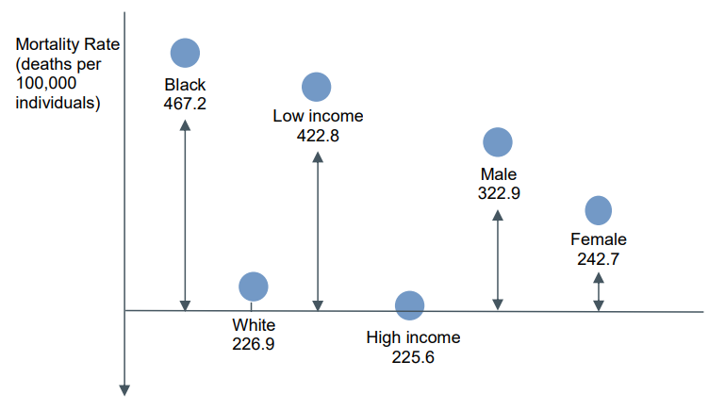
Disparity Data Pearls
In “Achieving Health Equity: A Guide for Health Care Organizations,” IHI advocates for these guiding principles in measuring health disparities:
Select a reference point – generally the group with the best outcomes
Measure in both absolute and relative terms – improvements can occur in two populations, but disparities can still widen
Express measures in terms of adverse events
Use pairwise comparisons (though this doesn’t capture intersectionality - i.e., race, gender, income, educational attainment)
Include summary measures

Slide 6
Guiding criteria:
Aligned to the SDoH
Data available at county, state and national level
Windsor County under performs VT
Potential exists to improve the indicator
Disparity Data Dashboard
SD | Indicator | Windsor | Orange | Grafton | Sullivan | VT | NH | US | Source
Education | Childcare capacity - the # of Head Start and Early Head Start programs located in or within 0.5 miles of a county boundary per 100,000 population. (2020; U.S. DHHS Administration for Children and Families) | 5.4 | 20.7 | 5.6 | 4.6 | 13.3 | 4.6 | 9.3 | US News & World Reports - https://www.usnews.com/news/healthiest-communities/rankings
Housing | % spending >30% of income on housing - the percentage of cost-burdened households, where housing costs (mortgage or rent, utilities, taxes and other costs) are 30% or more of total household income. (2015-2019 American Community Survey 5-year estimates, U.S. Census) | 33.2 | 31.6 | 31.5 | 33 | 32.8 | 30.6 | 23.4 | US News
Housing | Affordable housing shortfall - the availability of affordable housing for families that earn less than 30% of median area income. Negative numbers indicate a shortfall; (2015-2019 American Community Survey 5-year estimates, U.S. Census) | -68.9 | -51.9 | -50.9 | -54.3 | -61.9 | -60.1 | -62.3 | US News
Healthcare Access | Dental Providers/population Ratio of population to dentists. The 2021 Rankings used data from 2019 for this measure. | 1:1620 | 1:3210 | 1:1120 | 1:2540 | 1: 1370 | 1: 1300 |  | County Health Rankings - https://www.countyhealthrankings.org/
Mental Health | Deaths of Despair - the rate of deaths due to suicide, alcohol-related disease and drug overdoses per 100,000 population. (2012-2018; CDC) | 48 | 40.9 | 37 | 49.6 | 41.6 | 53 | 43.3 | US News
Safety | Injury Deaths - # of deaths due to injury per 100,000 population. The 2021 Rankings used data from 2015-2019 for this measure. | 101 | 89 | 81 | 81 | 86 | 89 |  | County Health Rankings
Lifestyle | Excessive Drinking | 23 | 20 | 22 | 19 | 20 | 20 |  | County Health Rankings
Lifestyle | Youth MJ Use LGBTQ+ vs hetero | 65 vs 23 |  |  |  | 27 |  |  | YRBS
Environ- ment | % children testing high for lead - Blood Lead Levels (>5µg/dL) among Children < 72 Months of Age, 2017 | 2.4 | 2.5 | 1.9 | 4.0 | 1.5 | 2 |  | CDC https://www.cdc.gov/nceh/lead/data/state.htm
Social | Kids believe that matter LGBTQ+ vs hetero | 23 vs 65 |  |  |  | 59 |  |  | YRBS
Social | Poor Mental Health Days- Average # of mentally unhealthy days reported in past 30 days (age-adjusted). The 2021 Rankings used data from 2018 for this measure. | 4.5 | 4.6 | 4.4 | 4.7 | 4.2 | 4.6 |  | US News
Health | Premature Death - Years of potential life lost before age 75 per 100,000 population (age-adjusted). The 2021 Rankings used data from 2017-2019 for this measure. | 6700 | 6000 | 5600 | 6100 | 6300 | 6400 |  | County Health Rankings

Slide 7
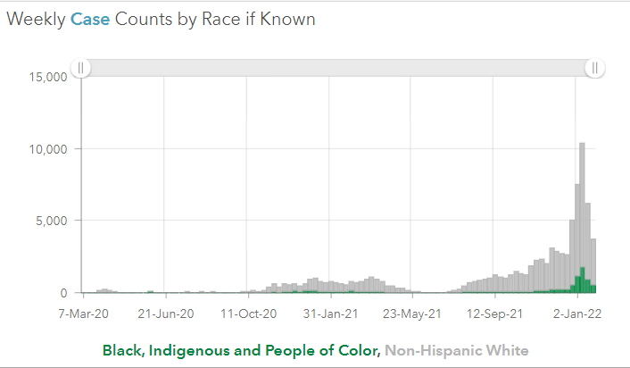
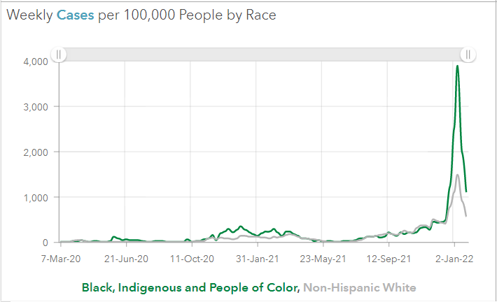
Weekly Covid-19 Case Counts and Rates by Race
VT COVID-19 Public Dashboard PRD v2.0 EB Container (arcgis.com)

Slide 8
Rudolph.Fedrizzi@vermont.gov
Lyrica.Stelle@vermont.gov

